Slide 1
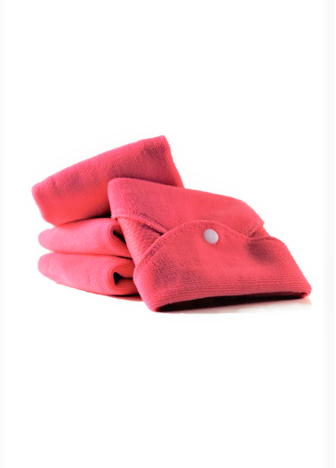
Ambitious Africa
February 2021
Notes:
1

Slide 2
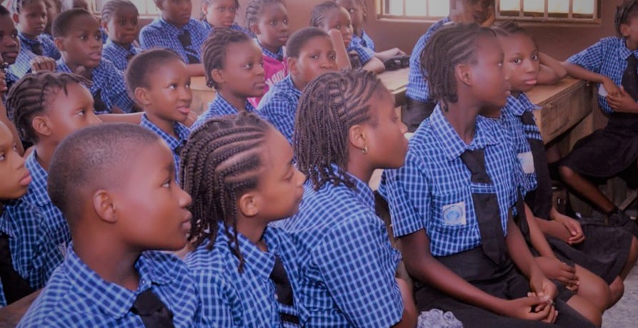
“Education is the most powerful weapon which you can use to change the world”
//Nelon Mandela

Slide 3
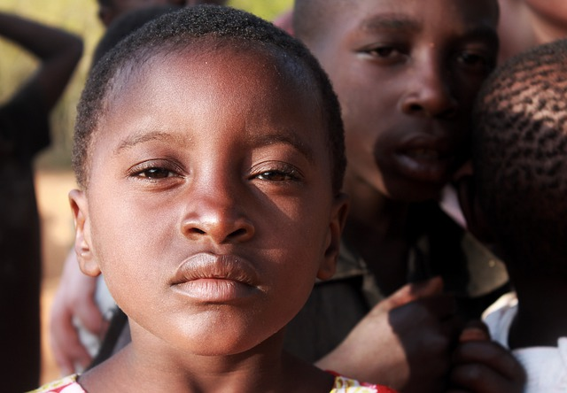
Without pads
Girls in developing countries miss up to 5 days of education monthly while they menstruate.
They use rags, blankets, pieces of mattress, tissue paper or cotton wool.
They feel ashamed and impure, and some girls even engage in transactional sex to obtain sanitary pads.
Missing school may result in getting lower grades or even dropping out of school.
This may lead to early marriage & parenting.

Slide 4
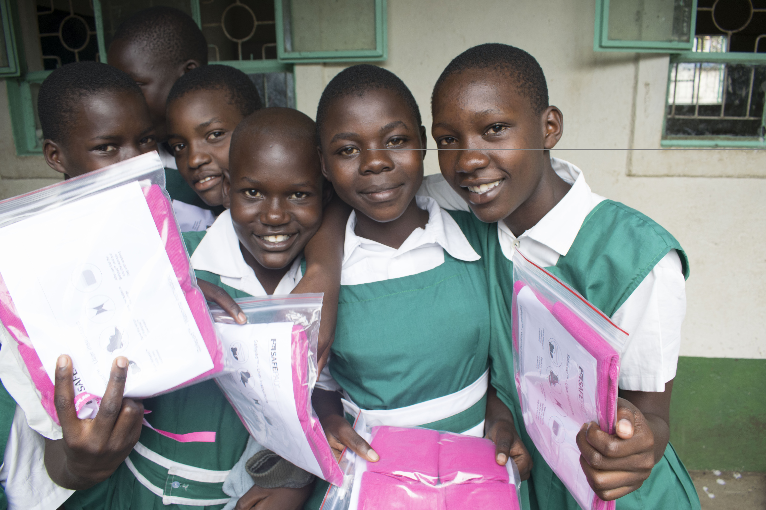
With pads
The availability & use of reusable sanitary pads, will keep the girls in school during their period, offering better opportunities for further education and a future job.
With an education the girls can work to break down the taboos & the cycle of shame for next generations.
With a better economy, they can afford buying new menstrual sanitary products when needed, and provide them to their own daughters, when that time comes.

Slide 5
Our solution
Notes:
5

Slide 6
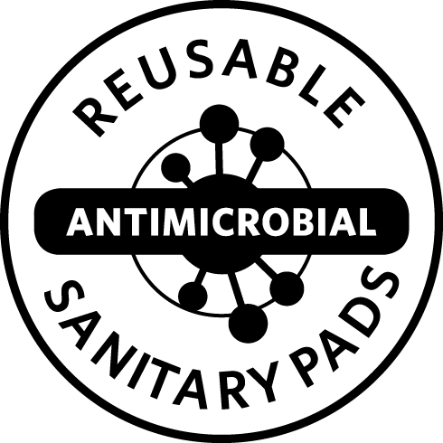
Safepad™ - reusable & antimicrobial sanitary pad
Safepad™ is a reusable sanitary pad designed to provide a safe and infection free experience.
75% of all women experience vaginal yeast or bacterial infections during their lifetime. These infections cause health issues and in worst cases will impact fertility.
Safepad™ hygienic sanitary pads are designed with a permanently bonded antimicrobial technology that helps reducing vaginal infections by removing yeast and bacteria during use and care. Safepad™ will sterilize itself after wash.
Our solution
Notes:
6

Slide 7
Other features and benefits
Safepad™ is designed to provide a safe and infection free experience while in use.
Safepad™ will sterilize itself during use and after wash, therefore providing protection against infections. Can be dried in-door in less than 1 hour, ensuring privacy.
Safepad™ fabric technology ensures high and immediate absorbency, non-leakage and quick drying after wash.
Safepad™ is made of a soft fabric material, that causes no irritation and offers reusability, protection and comfort.
Our solution
Notes:
7

Slide 8
Other features and benefits
Safepad™ is easy to use and requires little or no training.
Durable: One Safepad can be used up to 100 times.
Economic: A Packet contains 4 pads of different sizes (1 for night-times and 3 for day-times). Lasting for min. 3 year. Resulting in significant savings for HH.
Environmentally friendly.
Our solution
Notes:
8

Slide 9
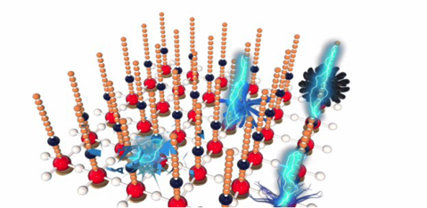
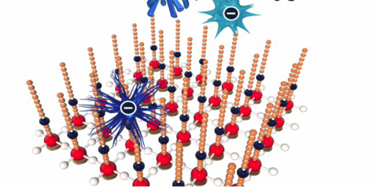
How does it work
Notes:
9

Slide 10
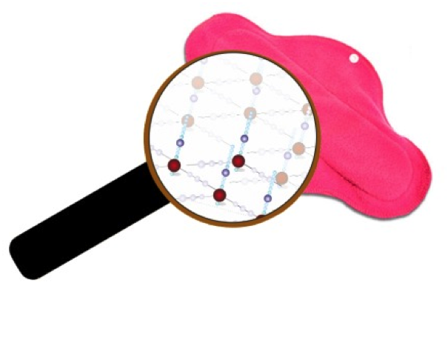
Safepad™ - Anti-microbial property
Safepad™ has a permanently bonded anti-microbial property that continuously kills pathogen (bacteria, fungi, microbes) on contact.
The antimicrobial shield is permanently bonded to the fabric. It does not deteriorate over time, nor does it liberate harmful chemicals. Safepad™ does not contain antibiotics.
The antimicrobial fabric along with a highly absorbent material provides a comfortable and hygienic experience for the users
How does it work
Notes:
10

Slide 11
Safepad™ - Core of technology
Safepad™ is constructed with a special fabric that has a permanently bonded anti-microbial shield. This shield is formed by a chain of carbon atoms attached to +vely charged Nitrogen & Silica.
The core principle of action is as follows: All pathogens (including bacteria, fungi such as Candida Albicans) are negatively charged.
The shield on Safepad™ has a positive charge and it attracts the pathogens. The Carbon atom chain acts as knives and kills the pathogen.
This shield is permanent and does not deteriorate in use or washing. The presence of this shield provides continuous anti-microbial action and kills pathogens.
How does it work
Notes:
11

Slide 12
Safepad™ - Core of technology
Each microknive on the fabric is positively charged
Attract: Pathogens are
negatively charged and are attracted to the fabric
Kill: Pathogen cell membranes are disrupted electro-mechanically
How does it work
Notes:
12

Slide 13
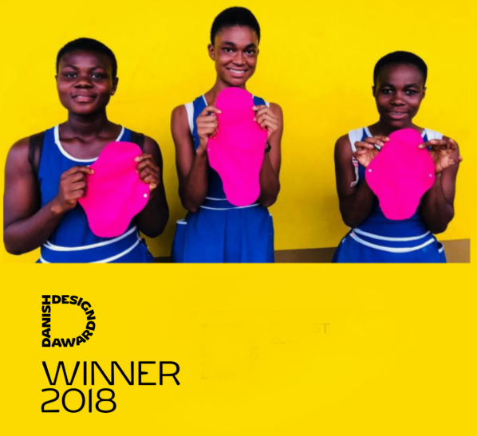
To us design means action
Antimicrobial
High absorbency
No irritation
Reusable
Comfortable

Slide 14
Health, education and gender equality
Seeing MHM is a multifaceted and complicated public health issue, it inevitably cuts across distinct societal sectors and has an impact on
Health: Lack of access to proper menstrual products accounts for 21% of work absenteeism and forces many women and girls to resort to questionable unsanitary materials, which puts them at risk of contracting severe vaginal infections and in worst case infertility.
Education: Girls not having access to proper menstrual products causes school absenteeism and in worst case school drop-outs.
Gender equality: Women and girls not getting the proper education puts them in an unequal situation when compared to men and boys.
Why MHM and Safepad
Notes:
14

Slide 15
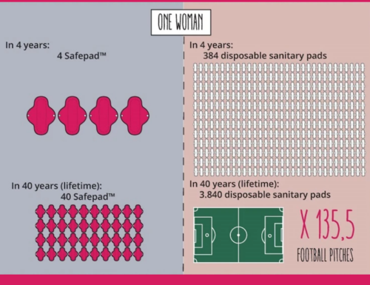
WASH and Global Health
WASH (Water, sanitation and hygiene): An intricate part of MHM, which often is insufficiently available for women and girls to properly manage their periods in a safe and confident way.
Environmental conservation: Menstrual waste generated from disposable pads and tampons, has a detrimental effect on the environment.
That is why Investing in MHM is investing in Global Health, as it has the capacity of remediating the negative impact on economic growth and societal development.
Why MHM and Safepad
Notes:
15

Slide 16
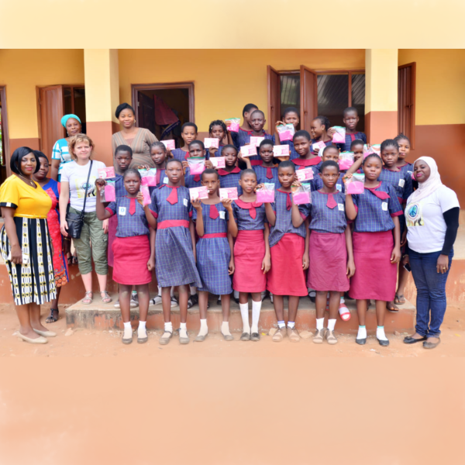
What can one pack of Safepad
do for 1 woman?
Avoid :
work absenteeism
school absenteeism
Infections
Infertility
Unwanted pregnancy
Early marriage
Child-bride-ism
A pack Safepad do for 1 woman
Notes:
16

Slide 17
What can one pack of Safepad
do for 1 woman?
Generate income for herself and her family
Build capacity in and for her community
Empower in self-reliance and self-worth
Manage her period in a safe and confident way
Restore her female dignity
A pack Safepad do for 1 woman
Notes:
17

Slide 18
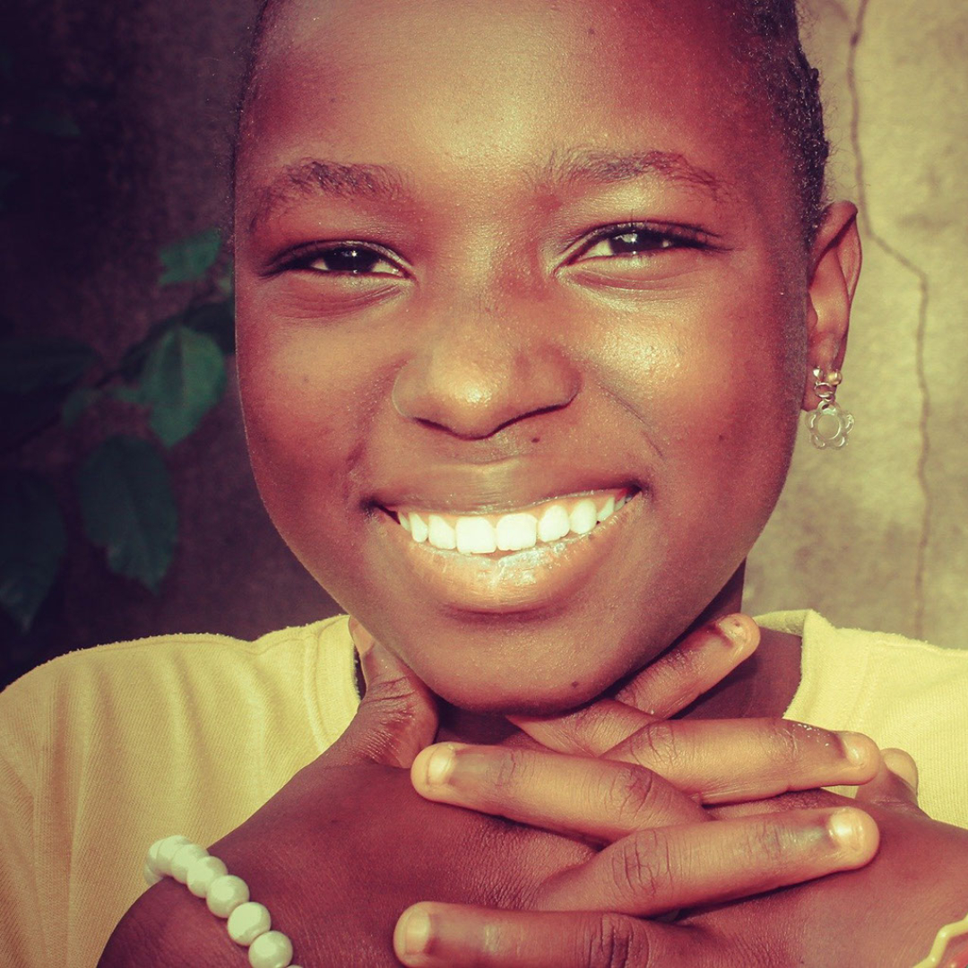
realreliefway.com
facebook.com/realreliefway
twitter.com/realreliefway
linkedin.com/company/real-relief
youtube.com/c/Realreliefway/videos
instagram.com/realreliefway
@realreliefway #safepad
www.realreliefway.com
Contact us

